Slide 1
Volumetric Properties of Pure Fluids

Slide 2
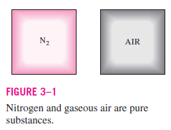
Some General Terms
PURE SUBSTANCE
A substance that has a fixed chemical composition throughout is called a pure substance.
Water, nitrogen, helium, and carbon dioxide, for example, are all pure substances.

Slide 3
A pure substance does not have to be of a single chemical element or compound, however, a mixture of various chemical elements or compounds also qualifies as a pure substance as long as the mixture is homogeneous.
Air, for example, is a mixture of several gases, but it is often considered to be a pure substance because it has a uniform chemical composition.
However, a mixture of oil and water is not a pure substance. Since oil is not soluble in water, it will collect on top of the water, forming two chemically dissimilar regions.

Slide 4
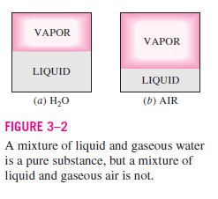
A mixture of two or more phases of a pure substance is still a pure substance as long as the chemical composition of all phases is the same.

Slide 5
A mixture of ice and liquid water, for example, is a pure substance because both phases have the same chemical composition.
A mixture of liquid air and gaseous air, however, is not a pure substance since the composition of liquid air is different from the composition of gaseous air, and thus the mixture is no longer chemically homogeneous.
This is due to different components in air condensing at different temperatures at a specified pressure.

Slide 6
PHASES OF A PURE SUBSTANCE
Substances exist in different phases.
Solid.
Liquid.
Gas.
At room temperature and pressure, copper is a solid, mercury is a liquid, and nitrogen is a gas.
Under different conditions, each may appear in a different phase.

Slide 7
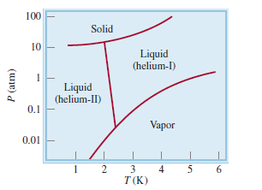
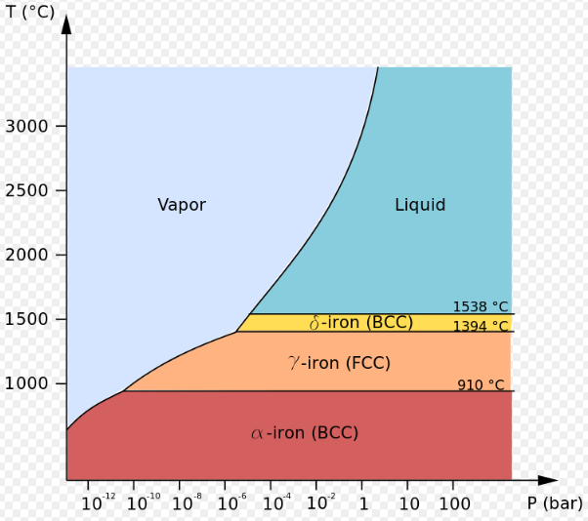
Even though there are three principal phases—solid, liquid, and gas—a substance may have several phases within a principal phase, each with a different molecular structure.
Carbon, for example, may exist as graphite or diamond in the solid phase
Helium has two liquid phases;
Iron has three solid phases.
Notes:
(is the property of some chemical elements to exist in two or more different forms)
Body centered cubic
Face centered cubic

Slide 8
PHASE-CHANGE PROCESSES OF PURE SUBSTANCES
There are many practical situations where two phases of a pure substance coexist in equilibrium.
Water exists as a mixture of liquid and vapor in the boiler and the condenser of a steam power plant.
The refrigerant turns from liquid to vapor in the freezer of a refrigerator.

Slide 9
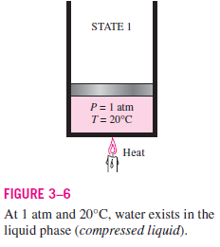
Compressed Liquid/Sub-cooled Liquid
Compressed Liquid
A liquid that is not about to vaporize

Slide 10
Consider a piston–cylinder device containing liquid water at 20°C and 1 atm pressure.
Under these conditions, water exists in the liquid
phase, and it is called a compressed liquid, or a subcooled liquid.
A liquid that is not about to vaporize
Heat is now transferred to the water
until its temperature rises to, say, 40°C.
Water is still a compressed liquid at
this state since it has not started to vaporize.

Slide 11
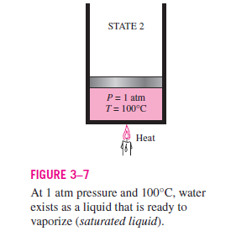
Saturated Liquid
Saturated Liquid
A liquid that is about to vaporize.

Slide 12
As more heat is transferred, the temperature keeps rising until it reaches 100°C.
At this point water is still a liquid, but any heat addition will cause some of the liquid to vaporize.
That is, a phase-change process from liquid to vapor is about to take place. A liquid that is about to vaporize is called a saturated liquid.

Slide 13
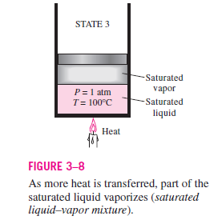
Saturated Liquid- Vapor Mixture
Midway about the vaporization line, the cylinder contains equal amounts of liquid and vapor.

Slide 14
Saturated Liquid- Vapor Mixture
Once boiling starts, the temperature stops rising until the liquid is completely vaporized.
That is, the temperature will remain constant during the entire phase-change process if the pressure is held constant.
Midway about the vaporization line, the cylinder contains equal amounts of liquid
and vapor.
Notes:
This can easily
be verified by placing a thermometer into boiling pure water on top of a
stove. At sea level (P 1 atm), the thermometer will always read 100°C if
the pan is uncovered or covered with a light lid.

Slide 15
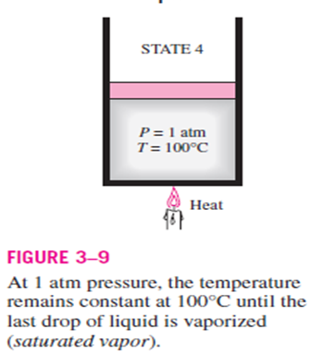
Saturated Vapors
Saturated Vapors
A vapor that is about to condense

Slide 16
Saturated Vapors
As we continue transferring heat, the vaporization process continues until the last drop of liquid is vaporized.
At this point, the entire cylinder is filled with vapor that is on the borderline of the liquid phase.
Any heat loss from this vapor will cause some of the vapor to condense (phase change from vapor to liquid).
A vapor that is about to condense is called a saturated vapor.
Notes:
This can easily
be verified by placing a thermometer into boiling pure water on top of a
stove. At sea level (P 1 atm), the thermometer will always read 100°C if
the pan is uncovered or covered with a light lid.

Slide 17
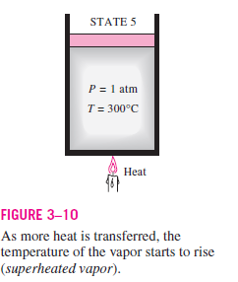
Superheated Vapors
Superheated Vapors
A vapor that is not about to condense.

Slide 18
Once the phase-change process is completed, we are back to a single phase region again (this time vapor),
A further transfer of heat results in an increase in both the temperature and the specific volume.
At this state, the temperature of the vapor is, let us say, 300°C; and if we transfer some heat from the vapor, the temperature may drop somewhat but no condensation will take place as long as the temperature remains above 100°C
(for P 1 atm).
A vapor that is not about to condense
(i.e., not a saturated vapor) is called a
superheated vapor.
Notes:
This can easily
be verified by placing a thermometer into boiling pure water on top of a
stove. At sea level (P 1 atm), the thermometer will always read 100°C if
the pan is uncovered or covered with a light lid.

Slide 19
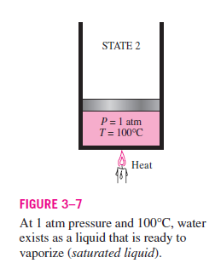
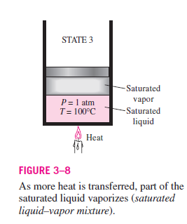
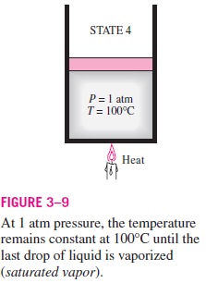
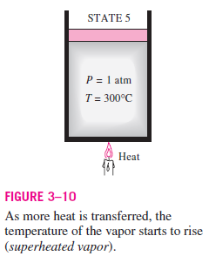

Slide 20
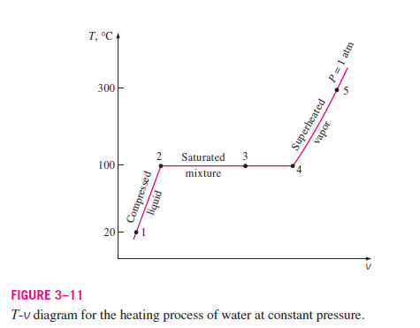
This constant-pressure phase-change process is illustrated on a T-v diagram

Slide 21
If the entire process described here is reversed by cooling the water while maintaining the pressure at the same value, the water will go back to state 1, retracing the same path, and in so doing, the amount of heat released will exactly match the amount of heat added during the heating process.

Slide 22
Saturation Temperature and Saturation Pressure
At a given pressure, the temperature at which a pure substance changes phase is called the saturation temperature T_{sat}.
At a given temperature, the pressure at which a pure substance changes phase is called the saturation pressure P_{sat}.
Saturation tables that list the P_{sat} against T_{sat} (or T_{sat} against P_{sat} ) are available for practically all substances
Notes:
At a pressure of 101.325 kPa, Tsat is 99.97°C.
Conversely, at a temperature of 99.97°C, Psat is 101.325 kPa.

Slide 23
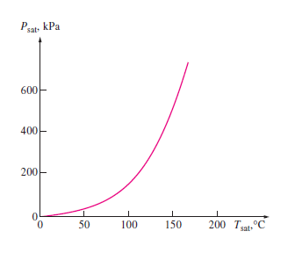
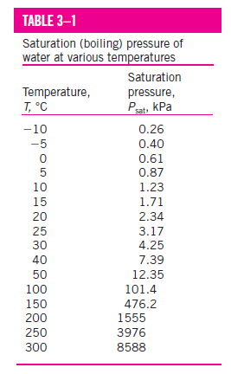
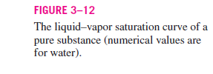
Liquid–vapor saturation curve

Slide 24
During a phase-change process, pressure and temperature are obviously dependent properties, and there is a definite relation between them, that is, T_{sat} = f (P_{sat}).
A plot of T_{sat} versus P_{sat}, such as the one given for water in Fig. 3–12, is called a liquid–vapor saturation curve.
A curve of this kind is characteristic of all pure substances.

Slide 25
Latent Heats
The amount of energy absorbed or released during a phase-change process is called the latent heat.
More specifically, the amount of energy absorbed during melting is called the latent heat of fusion and is equivalent to the amount of energy released during freezing.
Similarly, the amount of energy absorbed during vaporization is called the latent heat of vaporization and is equivalent to the energy released during condensation.

Slide 26
Some Concepts
A substance at higher pressures boils at higher temperatures.
In the kitchen, higher boiling temperatures mean shorter cooking times and energy savings. A beef stew, for example, may take 1 to 2 h to cook in a regular pan that operates at 1 atm pressure, but only 20 min in a pressure cooker operating at 3 atm absolute pressure (corresponding boiling temperature: 134°C).
The atmospheric pressure, and thus the boiling temperature of water,
decreases with elevation.

Slide 27
PROPERTY DIAGRAMS FOR PHASE CHANGE PROCESSES
The variation of properties during phase change processes for pure substances are best understood using property diagrams
The T-v Diagram (temperature as function of specific volume)
The P-v Diagram (Pressure as a function of specific volume)
and P-T Diagram ((Pressure as a function of temperature).

Slide 28
The T-v Diagram

Slide 29
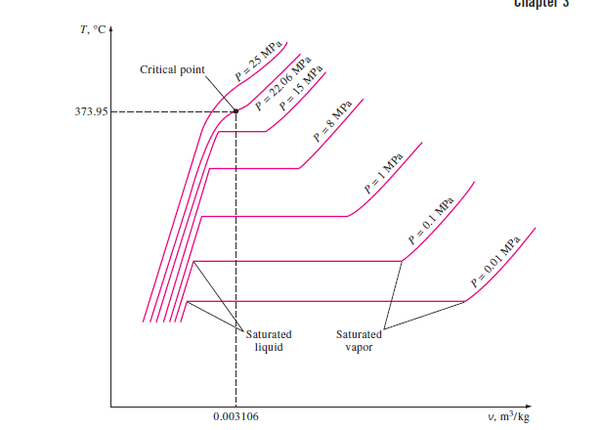

Slide 30
Comparison between 1 Mpa and 0.1Mpa (1 atm )
Let us add weights on top of the piston until the pressure inside the cylinder reaches 1 MPa.
At this pressure, water has a somewhat smaller specific volume than it does at 1 atm pressure.
As heat is transferred to the water at this new pressure:
First, water starts boiling at a much higher temperature (179.9°C) at this pressure
Second, the specific volume of the saturated liquid is larger and the specific volume of the saturated vapor is smaller than the corresponding values at 1 atm pressure.

Slide 31
The horizontal line that connects the saturated liquid and saturated vapor states is much shorter.
As the pressure is increased further, this saturation line continues to shrink and it becomes a point when the pressure reaches 22.06 MPa for the case of water.
This point is called the critical point, and it is defined as the point at which the saturated liquid and saturated vapor states are identical.
The temperature, pressure, and specific volume of a substance at the critical point are called, the critical temperature T_{cr} critical pressure P_{cr} and critical specific volume v_{cr} respectively.

Slide 32
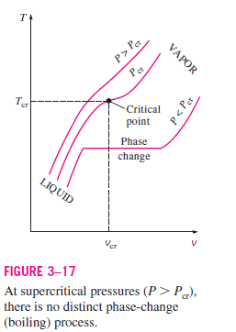
At pressures above the critical pressure, there is not a distinct phase change process (Fig. 3–17). Instead, the specific volume of the substance continually increases, and at all times there is only one phase present.

Slide 33
The saturated liquid states in Fig. 3–16 can be connected by a line called the saturated liquid line, and saturated vapor states in the same figure can be connected by another line, called the saturated vapor line.

Slide 34
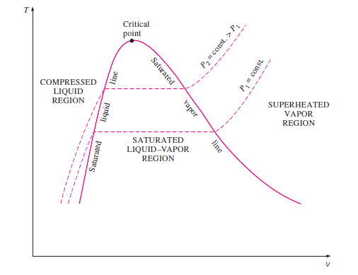


Slide 35
These two lines meet at the critical point, forming a dome as shown in Fig. 3–18.
All the compressed liquid states are located in the region to the left of the saturated liquid line, called the compressed liquid region.
All the superheated vapor states are located to the right of the saturated vapor line, called the superheated vapor region.
In these two regions, the substance exists in a single phase, a liquid or a vapor.
All the states that involve both phases in equilibrium are located under the dome, called the saturated liquid–vapor mixture region, or the wet region.

Slide 36
Above the critical state, there is no line that separates the compressed liquid region and the superheated vapor region.
However, it is customary to refer to the substance as superheated vapor at temperatures above the critical temperature and as compressed liquid at temperatures below the critical temperature.

Slide 37
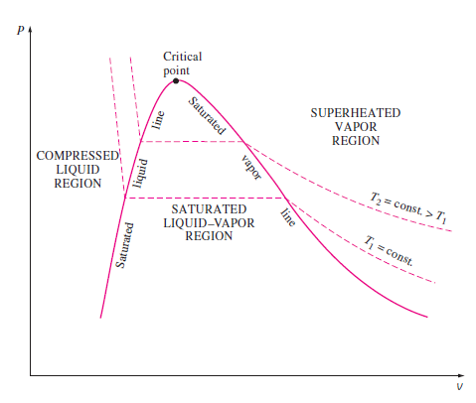
The P-v Diagram
The general shape of the P-v diagram of a pure substance is very much like the T-v diagram, but the T = constant lines on this diagram have a downward trend, as shown in Figure.

Slide 38
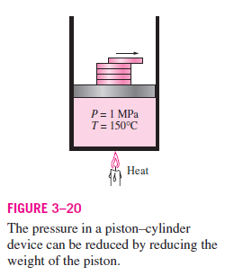
Consider again a piston–cylinder device that contains liquid water at 1 MPa and 150°C.
Water at this state exists as a compressed liquid.
Now the weights on top of the piston are removed one by one so that the pressure inside the cylinder decreases gradually
The water is allowed to exchange heat with the surroundings so its temperature
remains constant.
As the pressure decreases, the volume of
the water increases slightly.

Slide 39
When the pressure reaches the saturation-pressure value at the specified temperature (0.4762 MPa), the water starts to boil.
During this vaporization process, both the temperature and the pressure remain constant, but the specific volume increases. (Notice that during the phase-change process, we did not remove any weights)
Once the last drop of liquid is vaporized, further reduction in pressure results in a further increase in specific volume.

Slide 40
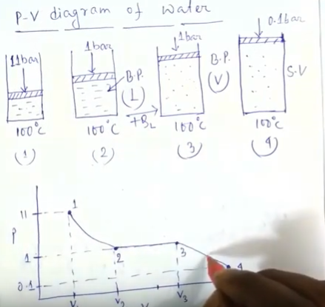

Slide 41
Extending the Diagrams to Include the Solid Phase
These diagrams can easily be extended to include the solid phase as well as the solid–liquid and the solid–vapor saturation regions.
The basic principles discussed in conjunction with the liquid–vapor phase-change process apply equally to the solid–liquid and solid–vapor phase-change processes.
Most substances contract during a solidification (i.e., freezing) process. Others, like water, expand as they freeze.

Slide 42
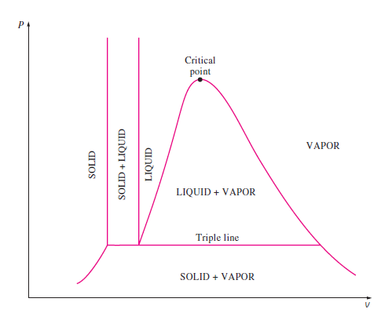
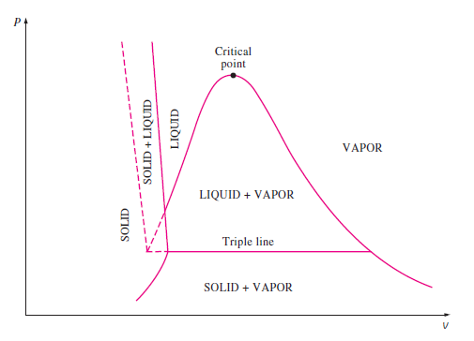



Slide 43
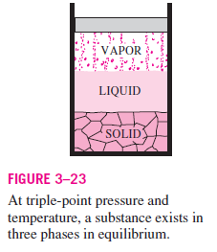
The T-v diagrams look very much like the P-v diagrams, especially for substances that contract on freezing.
Triple point: Under some conditions all three phases of a pure substance coexist in equilibrium.
On P-v or T-v diagrams, these triple-phase states form a line called the triple line.
The states on the triple line of a substance have the same pressure and temperature but
different specific volumes.

Slide 44
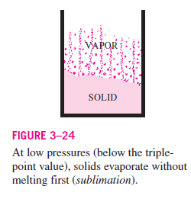
There are two ways a substance can pass from the solid to vapor phase: either it melts first into a liquid and subsequently evaporates, or it evaporates directly without melting first.
The latter occurs at pressures below the triple point value, since a pure substance cannot exist in the liquid phase at those pressures.
Passing from the solid phase directly into the vapor phase is called sublimation.
For substances that have a triple-point pressure above the atmospheric pressure such as
solid CO₂ (dry ice), sublimation is the
only way to change from the
solid to vapor phase
at atmospheric conditions.

Slide 45
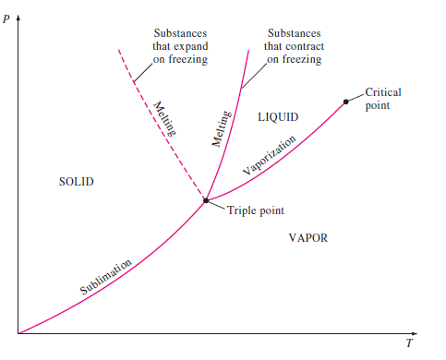
The P-T Diagram
This diagram is often called the phase diagram since all three phases are separated from each other by three lines.

Slide 46
The sublimation line separates the solid and vapor regions, the vaporization line separates the liquid and vapor regions, and the melting (or fusion) line separates the solid and liquid regions.
These three lines meet at the triple point, where all three phases coexist in equilibrium.
The vaporization line ends at the critical point because no distinction can be made between liquid and vapor phases above the critical point.
Substances that expand and contract on freezing differ only in the melting line on the P-T diagram.

Slide 47
The P-v-T Surface
We can represent the P-v-T behavior of a substance as a surface in three dimensions, as shown in Figs.
Here T and v may be viewed as the independent variables (the base) and P as the dependent variable
(the height).
The P-v-T surfaces present a great deal of information at once, but in a thermodynamic analysis it is more convenient to work with two-dimensional diagrams, such as the P-v and T-v diagrams

Slide 48
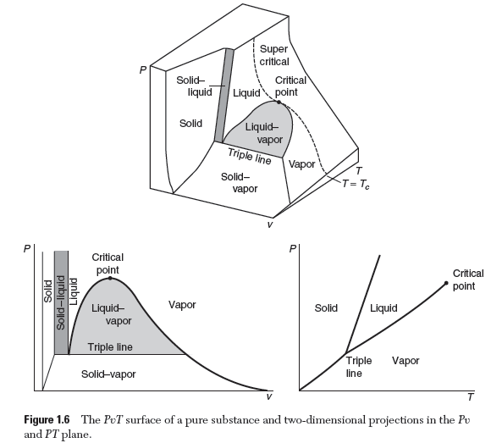

Slide 49
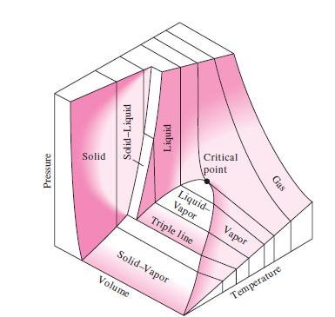
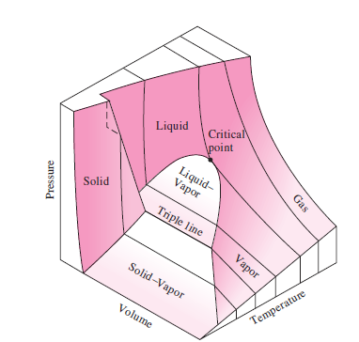



Slide 50
The single-phase regions appear as curved surfaces on the P-v-T surface.
The two-phase regions as surfaces perpendicular to the P-T plane.
This is expected since the projections of two-phase regions on the P-T plane are lines.
All the two-dimensional diagrams we have discussed so far are merely projections of this three-dimensional surface onto the appropriate planes
P-v diagram is just a projection of the P-v-T surface on the P-v plane

Slide 51
